Slide 1

Task Manager
Improve Your Life

Slide 2
Meet the Team
Project Manager
Lauren P. Dacre
Frontend | Functionality | API | Database
Mark N. | Steffen C. | Alexander H. | Matthew B.
 | Dennis G.
 | Adam H.

Slide 3









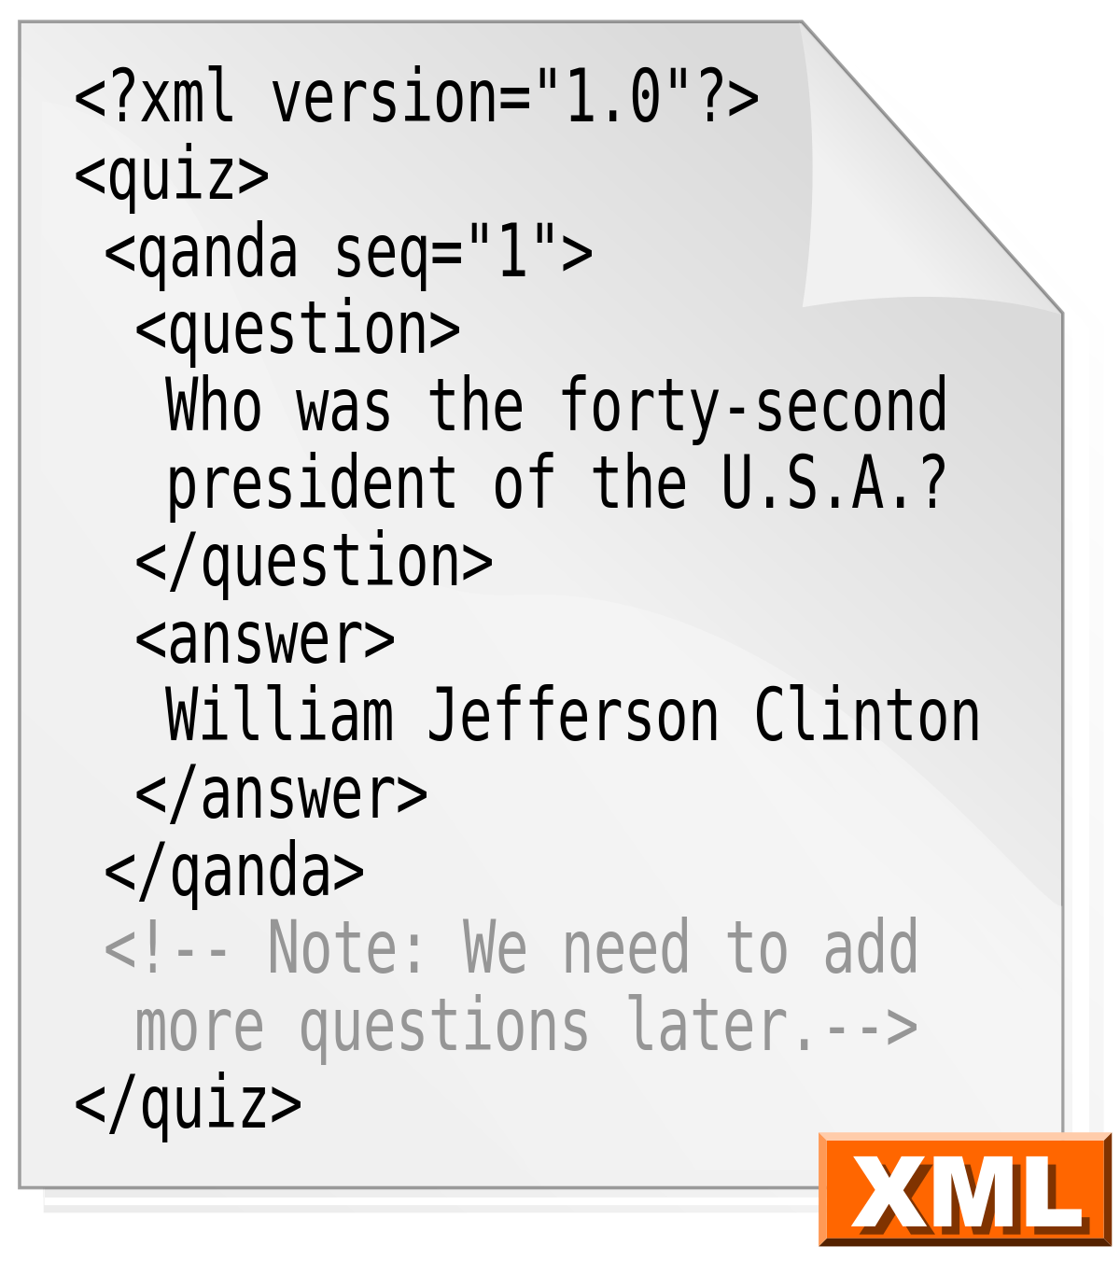

Technology Used

Slide 4
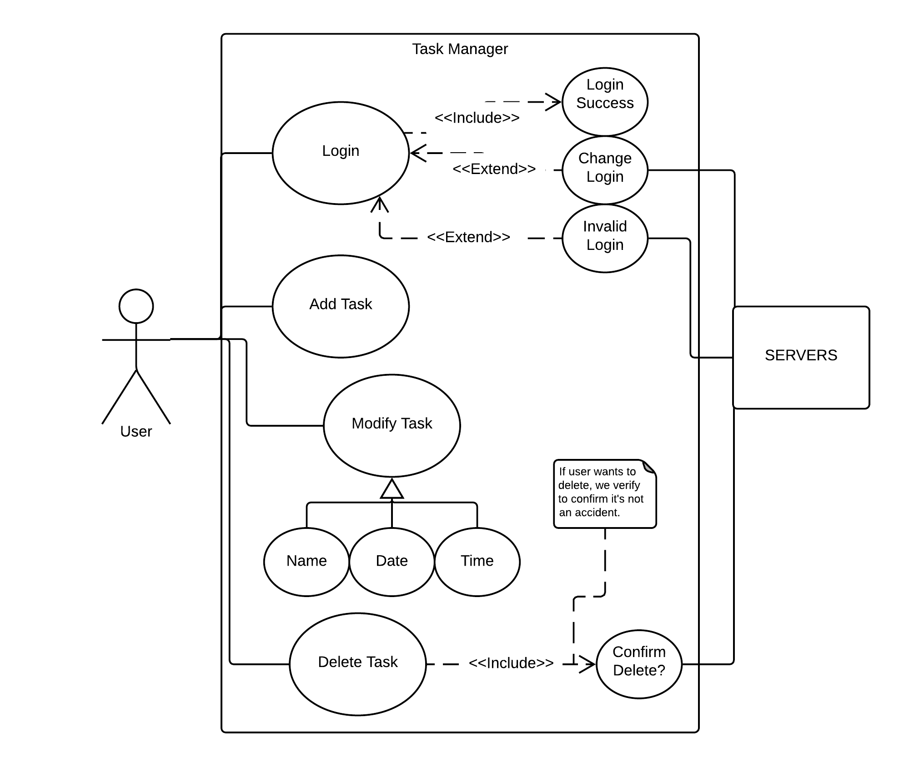
Use Case Diagram
An Overall View
User first creates an account which allows them to register with a username and password to store their information
The user is able to add tasks and delete tasks as needed.
Modifying tasks are simple and allows the user to update their tasks or mark them as completed
The server will keep track of any changes to the account information such as passwords, which will be encrypted on the user end.

Slide 5
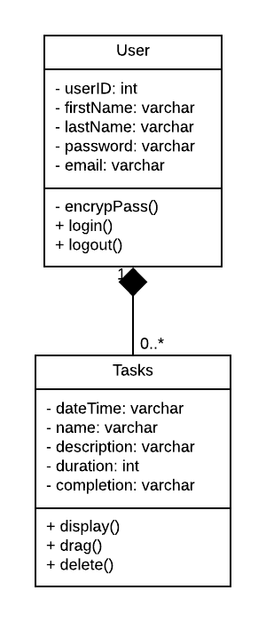
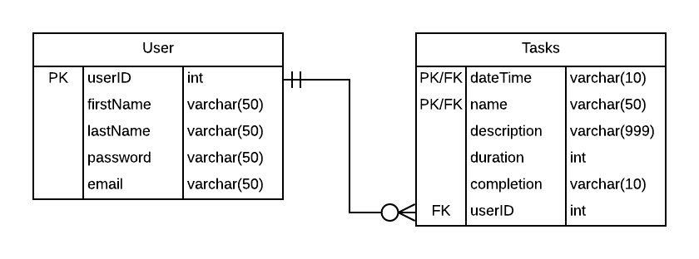
Class Diagram and Entity-Relationship Diagram
Class
Entity-Relationship
We can have one user which can assign zero to many tasks.
Different methods allow to customize the viewing of the tasks, such as drag and drop features.
userID is the primary key for the user class while a composite key is used for the tasks class as a task name/date will be a unique combination.

Slide 6

Development Life Cycle
It all fits together
Modeling
Gathered the details about project such as UML Diagrams and ER Diagram.
Implementation
We learned how to execute the model, such as learning new software and applying those skills to building it.
Execution
Time to run the program. We designed and built the project, fixing errors along the way.
Monitoring
Making sure that the implementation and executing phases are being doing properly.
Optimization
We know what worked and did not work so we can make adjustments.

Slide 7
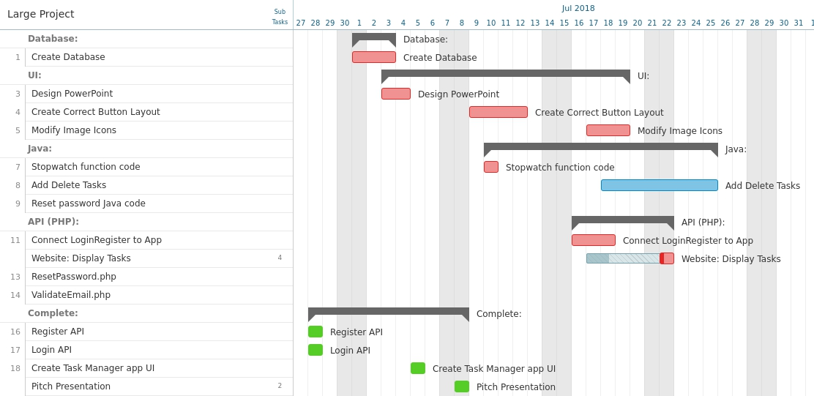
Gantt Chart
Keeping track
Each person was assigned a group in Asana, which was used to keep track of progression and tasks.
Working in an agile environment, tasks would pop up frequently for new items that needed to be completed.
Using Asana gave us a clear track of who was doing what and what was getting done in the project.

Slide 8

Issues Encountered
Android Studio
Issues running the emulator and hardware acceleration.
Not up-to-date software on all computers
Boat Anchor
We would decide on technology to use, but scrap the idea later (e.g. Slack).
Inexperience
No team members had experience in app design or certain programming languages.
Lack of experience delayed tasks and drastically slowed the progress of the project.

Slide 9

Live Demo

Slide 10
Questions?
View our site at m4rks.site

